Slide 1
Reducing Speaker and Temporal Redundancy in Discrete Speech Tokenization
Yiwei Guo
Ph.D. Candidate
X-LANCE Lab, School of Computer Science & Engineering
Shanghai Jiao Tong University, China
Presented at Cambridge University
2025-10-20

Slide 2
Contents
1
Discrete Speech Tokens: Taxonomy
2
Reducing Speaker Redundancy: Disentanglement
3
Reducing Temporal Redundancy: Variable Frame Rate
4
Conclusion
Notes:
I’ll be talking about several recent papers from the TTS group in our lab. While not all of them are my first-author, I’ve been closely involved in the projects, and they can well represent the recent progress of our research group.

Slide 3
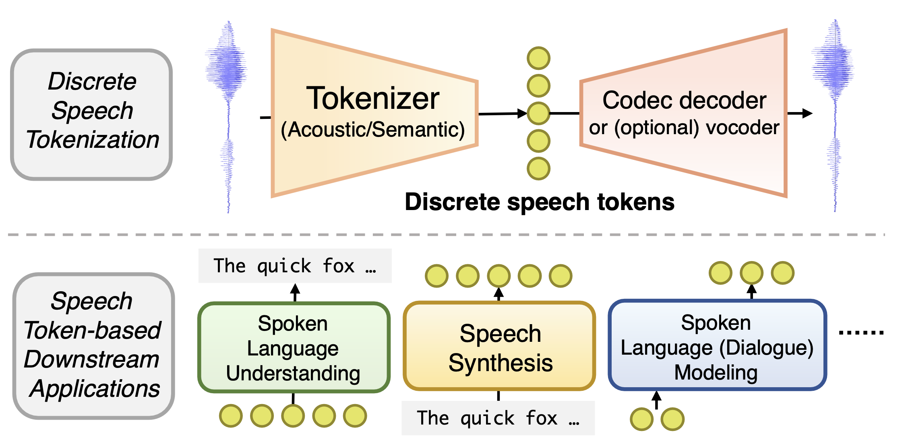
Discrete Speech Tokens: Taxonomy
Discrete Speech Tokens
Self-supervised learning for phonetic/semantic information
Transmission & storage
Tokenization for LLM generation

Slide 4
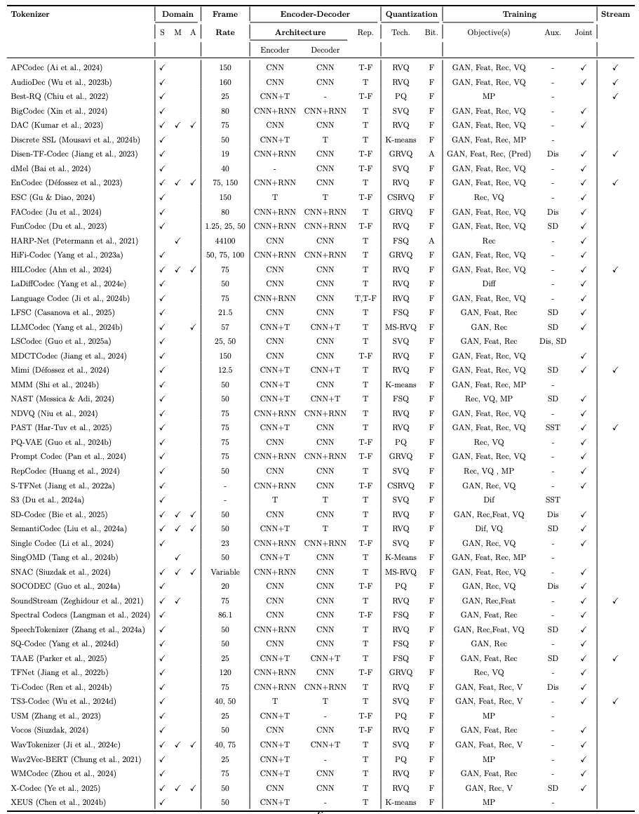
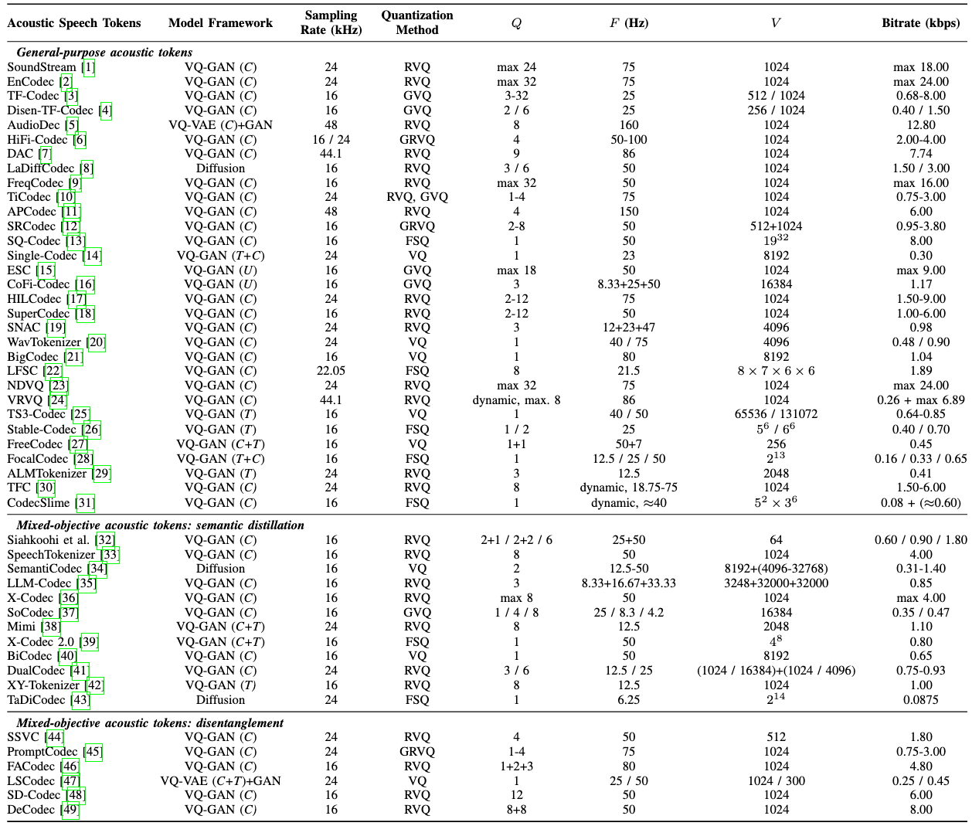
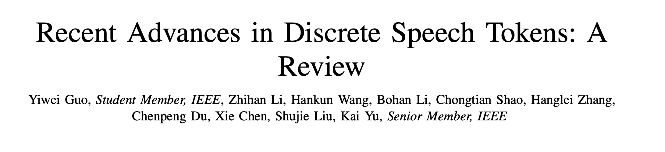
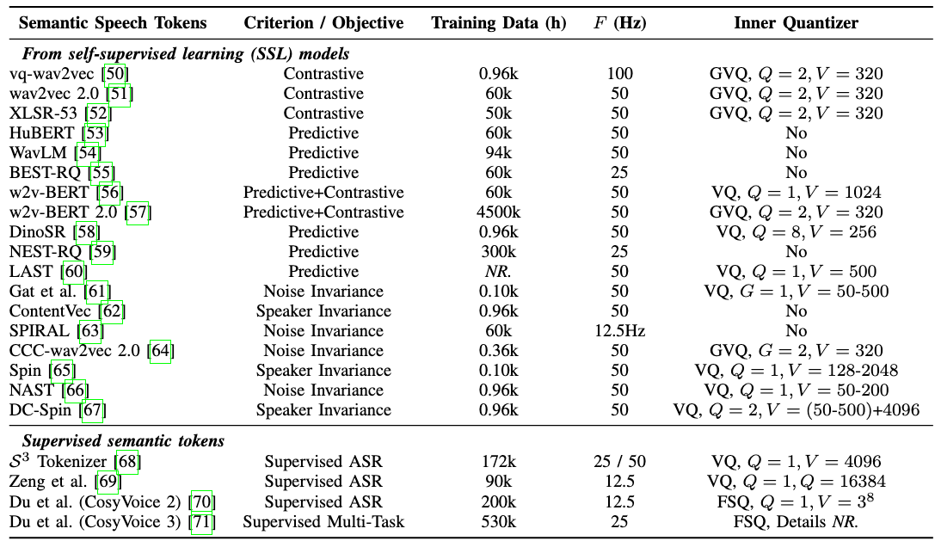
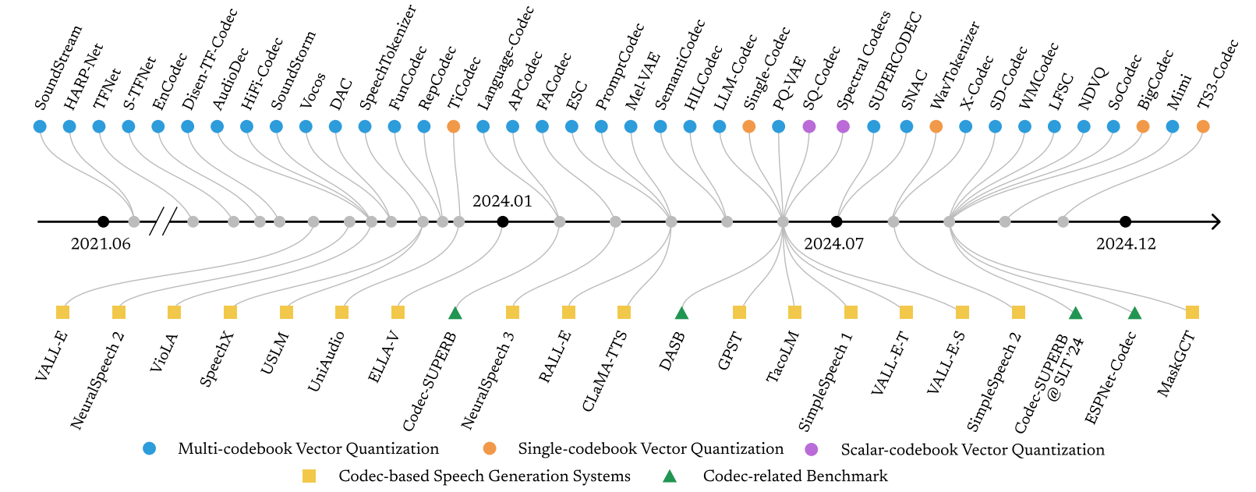
Discrete Speech Tokens: Taxonomy
ICASSP 2025 Tutorial
Arxiv: 2502.06490
Left two images:
Mousavi et al. 2025. Discrete Audio Tokens: More Than a Survey!. TMLR.
Chen et al. 2025. CodecFake+: A Large-Scale Neural Audio Codec-Based Deepfake Speech Dataset. Arxiv: 2501.08238

Slide 5
Discrete Speech Tokens: Taxonomy
General-purpose codec
VQ methods, diffusion, multi-resolution, variable bitrate…
Acoustic Token
Semantic distillation
Semantic guidance, semantic inputs/outputs, fixed semantic codebook…
Disentanglement
Speaker timbre, prosody, content, environment, source separation…
SSL tokens
Online vs. offline, predictive vs contrastive, perturbation invariance, …
Discrete Speech Token
Semantic Token
Supervised tokens
ASR, multi-task, …
Speech token vocoders
GAN, diffusion & flow, timbre controllability
Length reduction & variable-rate tokenization
Length reduction
Deduplication, BPE
Variable-rate tokenization
Unit discovery, boundary prediction, …
Notes:
Acoustic tokens means the main objective is to reconstruct a speech waveform from a discrete information bottleneck. In other words, these acoustic tokens are also called "codecs", and are initially designed for transmission and storage.

Slide 6
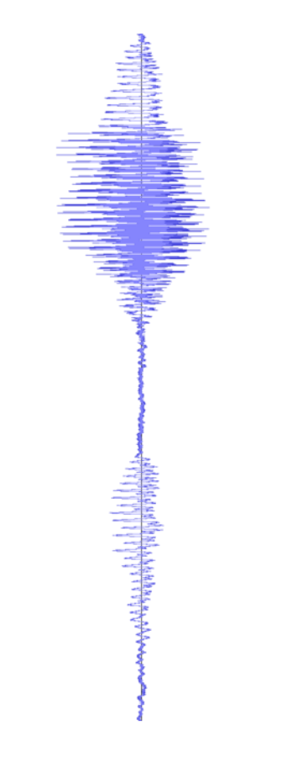






Background & Motivation
Speech tokens are still much less concise than text BPE units…
？
Speech
Tokenizer
Ideal speech tokens
For downstream LLMs
Waveforms
(≥256kbit/s)
Discrete speech tokens
(usually ≥1kbit/s)
Text BPE units
(≤0.1kbit/s)
Speech
LLM
Text
LLM
Notes:
Even for traditional application of discrete speech tokens, such as transmission, further reducing the bitrate of speech tokens to match that of text units is still necessary, because the cascaded ASR and TTS systems lose too much acoustic information.

Slide 7
Background & Motivation
We aim to reduce two types of redundancies in tokens
Speaker timbre redundancy
Speech
Tokenizer
For a single speaker, timbre is a global feature that doesn't need to be encoded in time-varying codes
Temporal redundancy
Information in speech is non-uniform
Constant frame rate: wastes some tokens
Waveforms
(≥256kbit/s)
Discrete speech tokens
(usually ≥1kbit/s)
Notes:
Even for traditional application of discrete speech tokens, such as transmission, further reducing the bitrate of speech tokens to match that of text units is still necessary, because the cascaded ASR and TTS systems lose too much acoustic information.

Slide 8
Contents
1
Discrete Speech Tokens: Taxonomy
2
Reducing Speaker Redundancy: Disentanglement
3
Reducing Temporal Redundancy: Variable Frame Rate
4
Conclusion

Slide 9

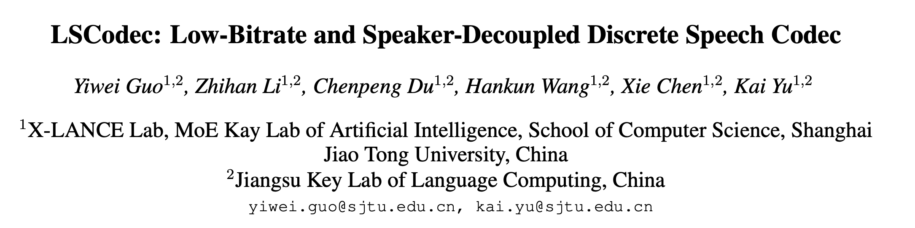

LSCodec: Low-Bitrate Speaker-Decoupled Codec
Luckily, disentanglement helps reduce the bitrate!
Emotion & Prosody
Interspeech 2025
Codec
Encoder
Text Content
Hello!
Hello!
Speaker Timbre

Slide 10
LSCodec: Low-Bitrate Speaker-Decoupled Codec
Properties:
Single-layer VQ, reasonably low frame rate
Explicit speaker information removal in the quantized codes
Good intelligibility + prosody preservation
Unsupervised

Slide 11







LSCodec: Low-Bitrate Speaker-Decoupled Codec Core Ideas
Challenges
Solutions
Speaker perturbations
Unsupervised speaker removal
SSL-based speaker control
Learning a single-layer VQ space
Multi-stage training
Semantic distillation

Slide 12
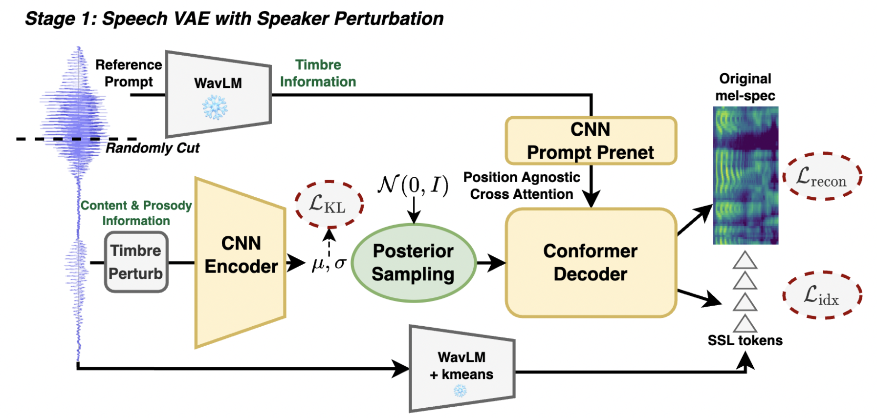
LSCodec: Low-Bitrate Speaker-Decoupled Codec Method
Continuous VAE training
Discrete VQ-VAE training
Vocoder training
Main task: mel reconstruction
Speaker decoupled representation learning
Filling in acoustic details

Slide 13
LSCodec: Low-Bitrate Speaker-Decoupled Codec Method
Continuous VAE training
Discrete VQ-VAE training
Vocoder training
WavLM features provide strong timbre information

Slide 14
LSCodec: Low-Bitrate Speaker-Decoupled Codec Method
Continuous VAE training
Discrete VQ-VAE training
Vocoder training
No position embedding in cross-attention

Slide 15
LSCodec: Low-Bitrate Speaker-Decoupled Codec Method
Continuous VAE training
Discrete VQ-VAE training
Vocoder training
Time stretch-based timbre perturbation

Slide 16
LSCodec: Low-Bitrate Speaker-Decoupled Codec Method
Continuous VAE training
Discrete VQ-VAE training
Vocoder training
Auxiliary semantic token prediction task

Slide 17
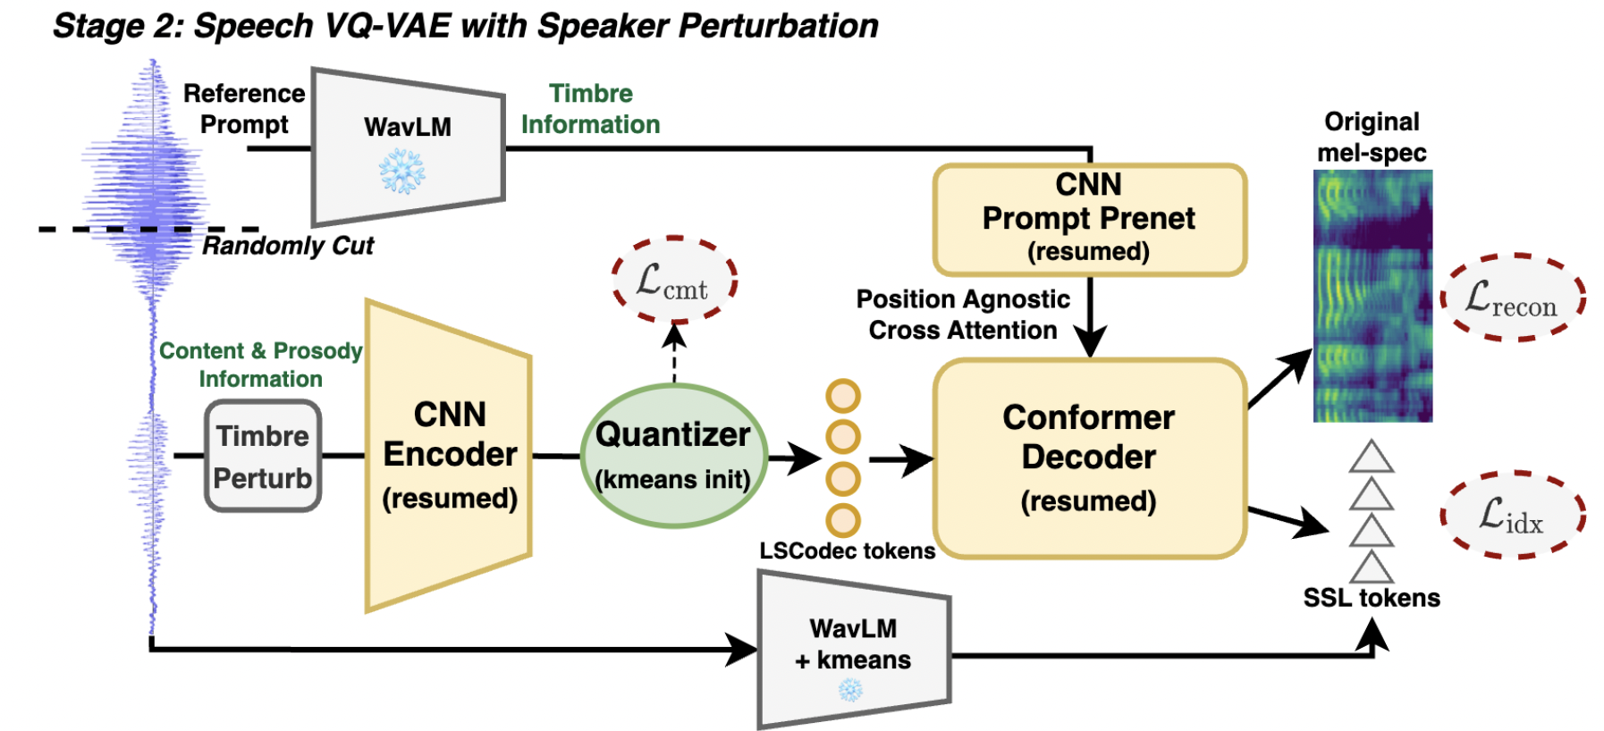
LSCodec: Low-Bitrate Speaker-Decoupled Codec Method
Continuous VAE training
Discrete VQ-VAE training
Vocoder training
Discrete space initiated from VAE latent

Slide 18
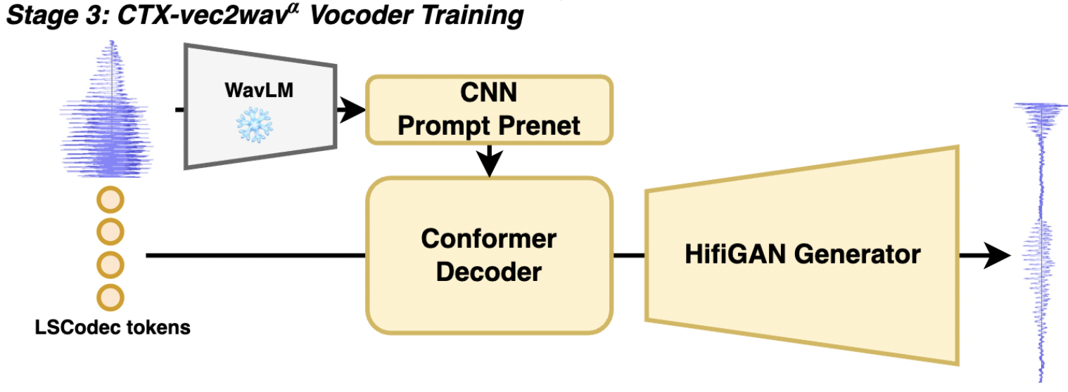
LSCodec: Low-Bitrate Speaker-Decoupled Codec Method
Continuous VAE training
Discrete VQ-VAE training
Vocoder training

Slide 19
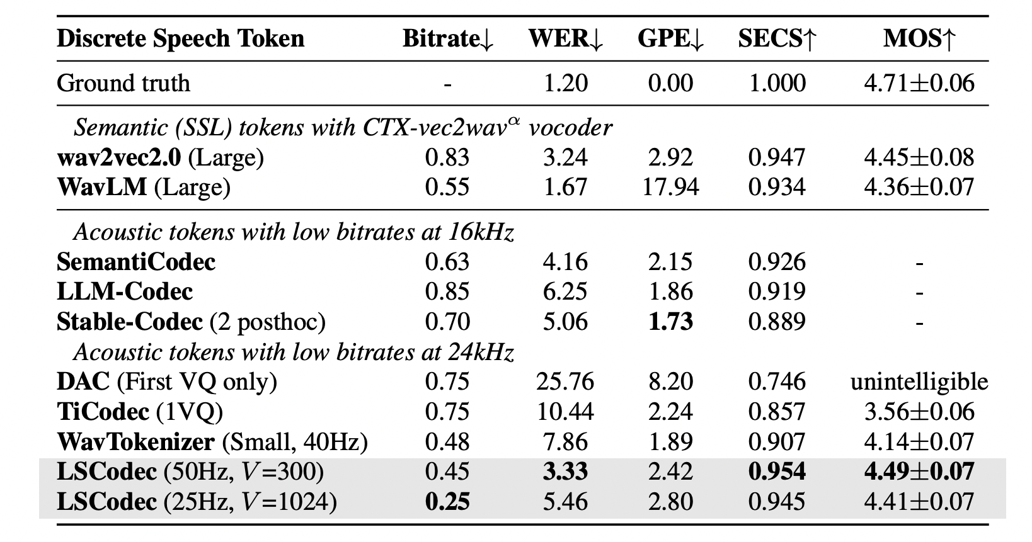
LSCodec: Low-Bitrate Speaker-Decoupled Codec
Speaker
Similarity
Better reconstruction quality at comparable bitrates
Intelligibility
Subjective
Quality
Prosody

Slide 20
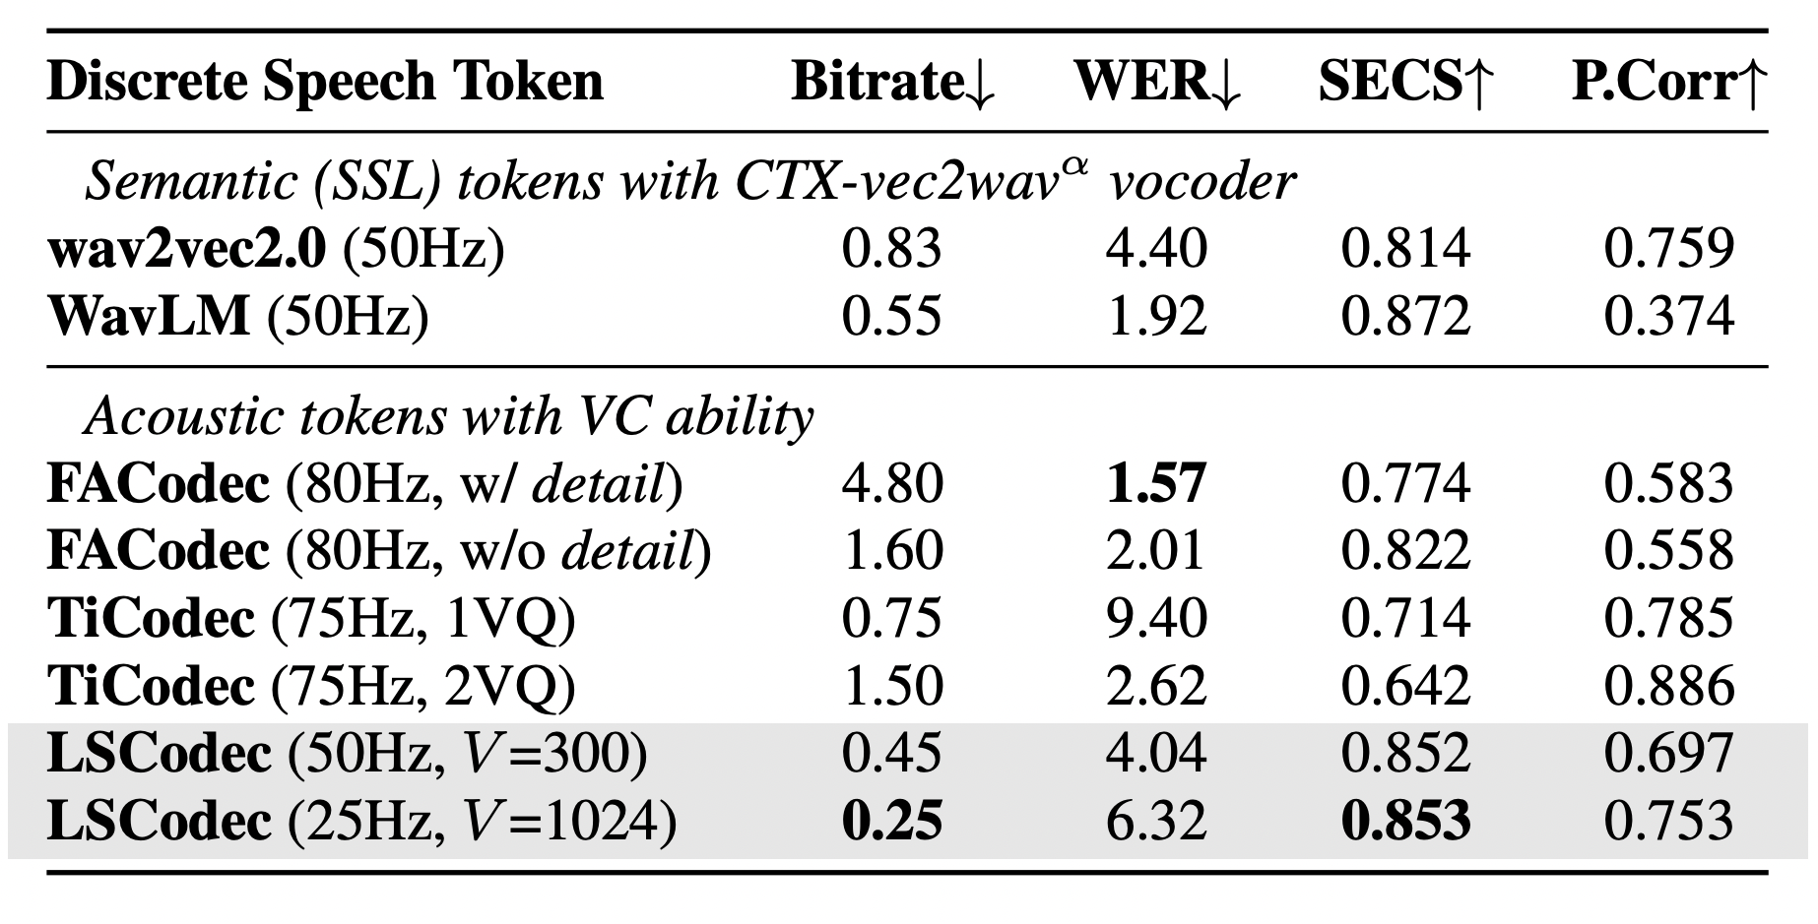
LSCodec: Low-Bitrate Speaker-Decoupled Codec Voice conversion
Superior speaker similarity
Meanwhile balanced prosody preservation
Prosody
(Pearson Corr. of F0)

Slide 21

LSCodec: Low-Bitrate Speaker-Decoupled Codec
Reconstruction
"Don't know; 'most everything she says sounds like the Bible or Shakespeare to me."
WavLM +km2048
(0.55kbps)
Ground
Truth
LSCodec
(0.45kbps)
LSCodec
(0.25kbps)
WavTokenizer
(0.48kbps)
wav2vec 2.0
(0.83kbps)
Voice Conversion
"Why dost thou, tyrant, boast thyself, Thy wicked deeds to praise?"
WavLM
+km2048
(0.55kbps)
Target
Speaker
LSCodec
(0.45kbps)
LSCodec
(0.25kbps)
FACodec
(2.4kbps)
wav2vec 2.0
(0.83kbps)
Source

Slide 22
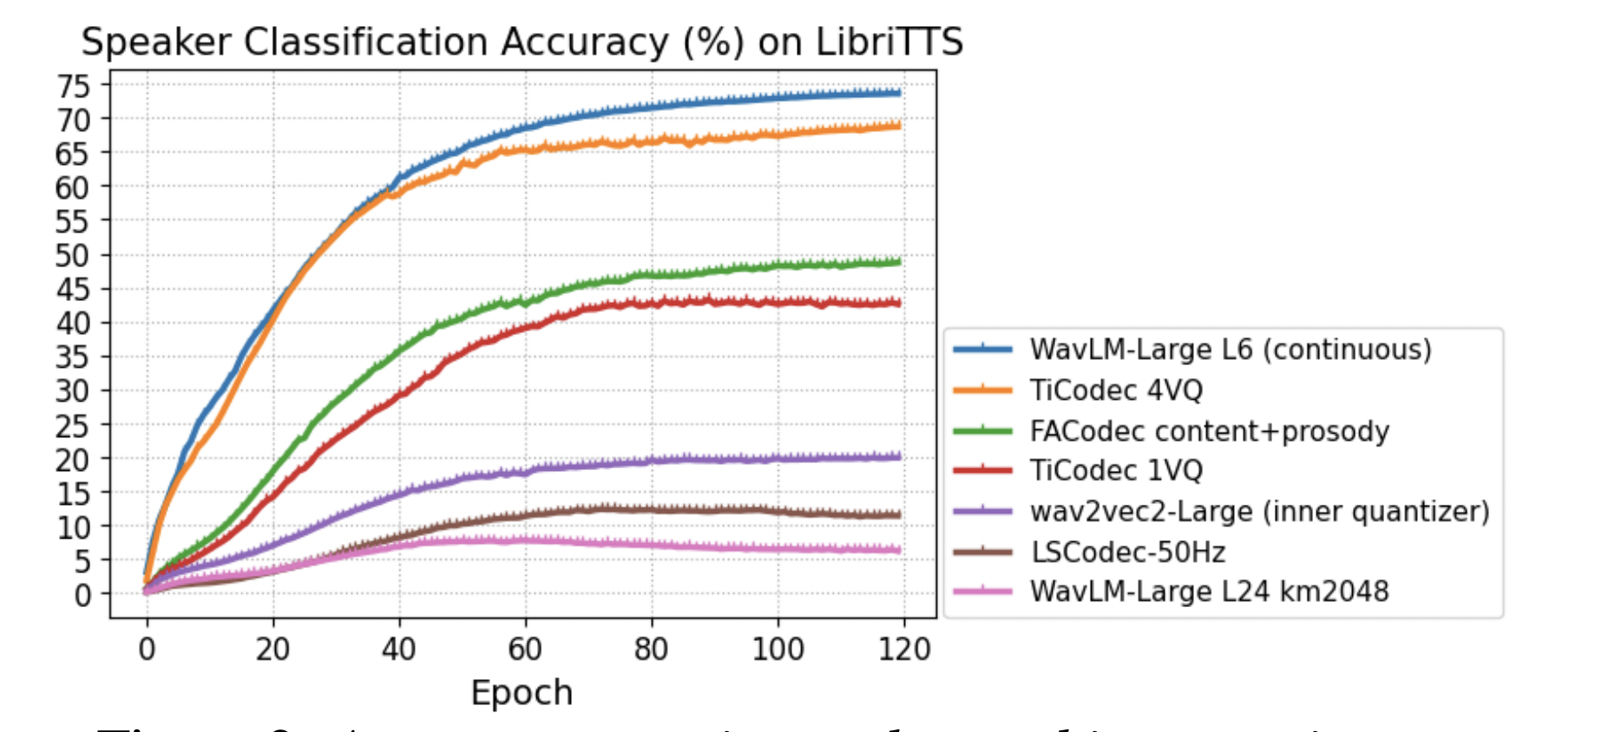
LSCodec: Low-Bitrate Speaker-Decoupled Codec Probing experiments
VC experiments are not enough to show "disentanglement"
Probing tasks are necessary
Speaker classification on LibriTTS, using codevectors are inputs
2nd lowest

Slide 23
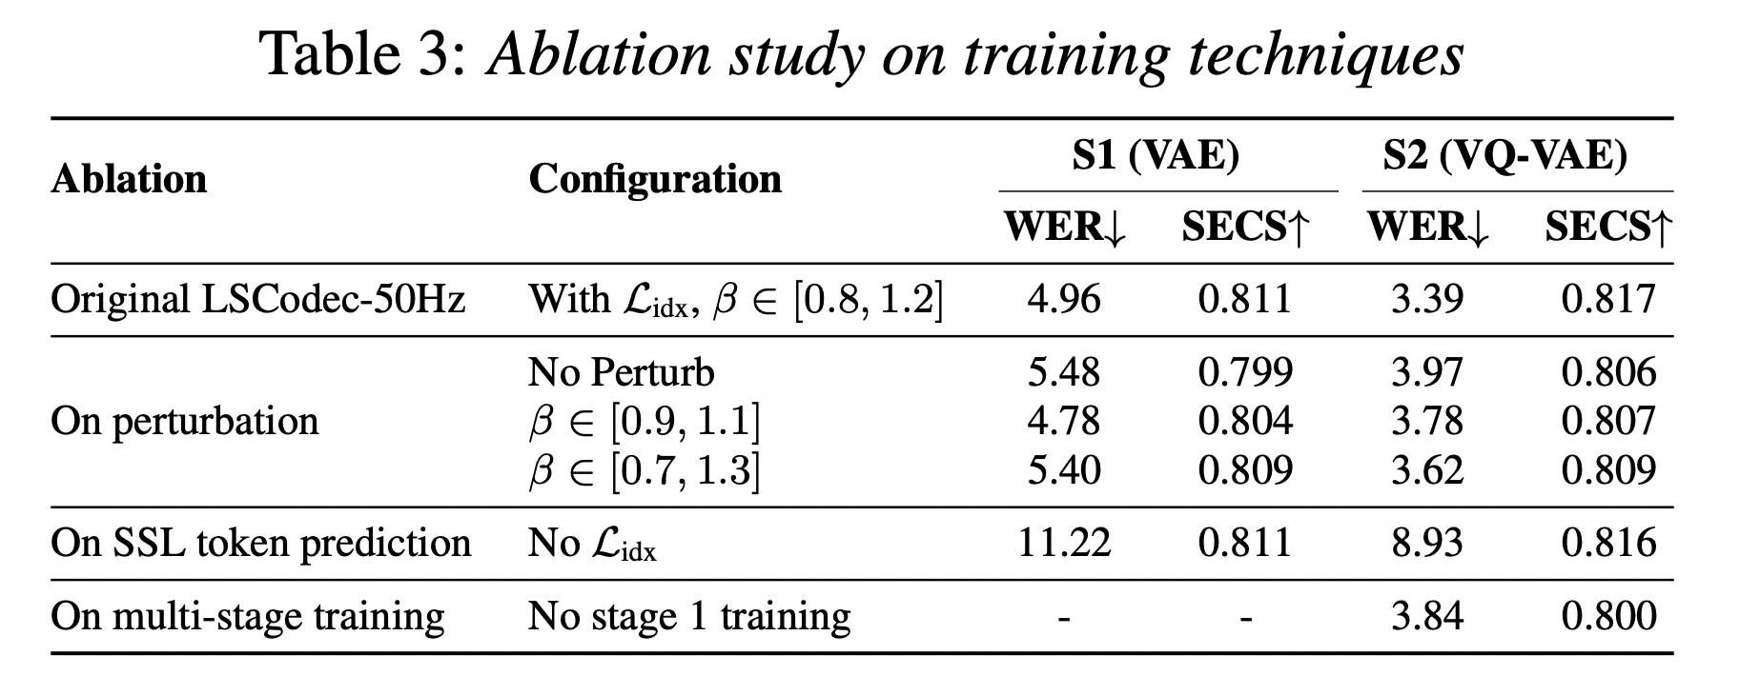
LSCodec: Low-Bitrate Speaker-Decoupled Codec Ablation studies
VAE -> VQVAE helps intelligibility and disentanglement
Perturbation coefficient should be carefully chosen
Auxiliary semantic token prediction is important for intelligibility

Slide 24

LSCodec: Low-Bitrate Speaker-Decoupled Codec Conclusion
Single-layer, low bitrate
Speaker-decoupled
Competitive reconstruction and voice conversion abilities
👇 Code is open-sourced!

Slide 25
Contents
1
Discrete Speech Tokens: Taxonomy
2
Reducing Speaker Redundancy: Disentanglement
3
Reducing Temporal Redundancy: Variable Frame Rate
4
Conclusion

Slide 26
Frame Rate & Bitrate: Some Concepts
Same fixed rate for all codebooks.
Quantizer dropout is applied globally.
Encoder
Quantizer
time
Standard codec
quantizers
Different but fixed frame rate for each codebook.
Encoder
Quantizer
time
Multi-resolution
codec (e.g. SNAC)
quantizers
Variable number of codebooks for each frame.
Still fixed frame rate for the first codebook.
Encoder
Quantizer
time
Variable-Bitrate
codec (e.g. VRVQ)
quantizers

Slide 27
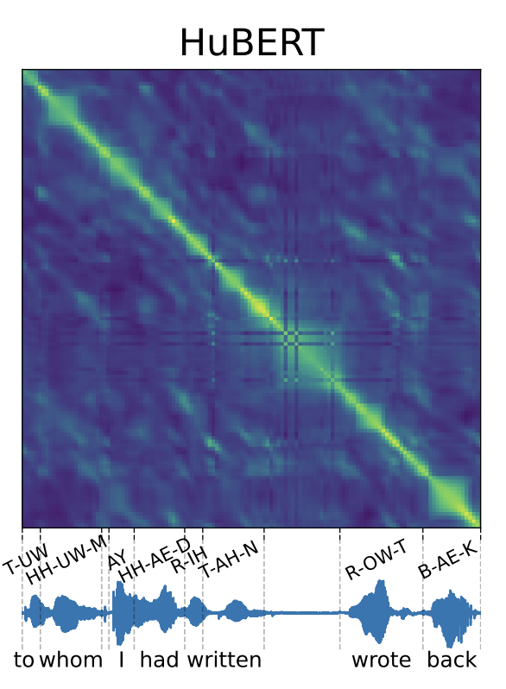
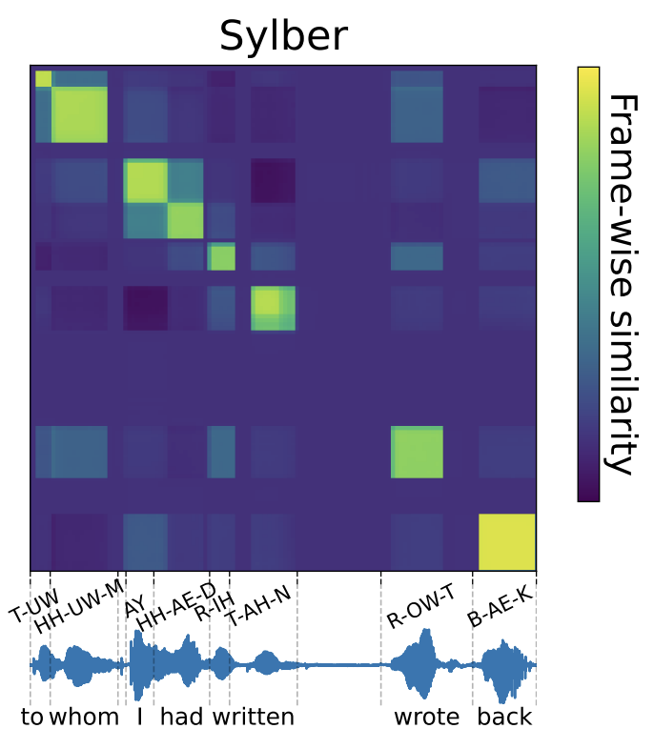
Variable Frame Rate (VFR) Tokens
VFR: each token covers dynamic time spans
Information-dense segments: more tokens. Vice versa.
Encoder
Quantizer
time
Variable Frame Rate
Codec
quantizers
Image source: Cho et al., 2025
Existing VFR tokens focus more on semantic tokens, and is related to unit discovery
Sylber, SyllableLM: merging adjacent features from SSL models
Boundary prediction
Text-aligned tokens
Baade, et al., SyllableLM: Learning Coarse Semantic Units for Speech Language Models. In Proc. ICLR 2025.
Cho et al., Sylber: Syllabic Embedding Representation of Speech from Raw Audio. In Proc. ICLR 2025.

Slide 28
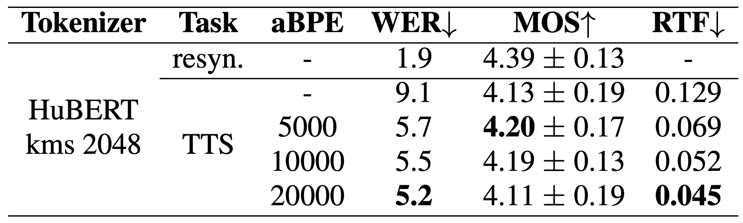
The Simplest VFR Token: BPE
Byte-Pair Encoding (BPE) merges most common token pairs
BPE has proven effective for semantic tokens, both for TTS and spoken language modeling
Also reflects the information density in tokens
Shen et al., Acoustic BPE for speech generation with discrete tokens. In Proc. ICASSP 2024.
Li et al., On the Effectiveness of Acoustic BPE in Decoder-Only TTS. In Proc. Interspeech 2024.

Slide 29

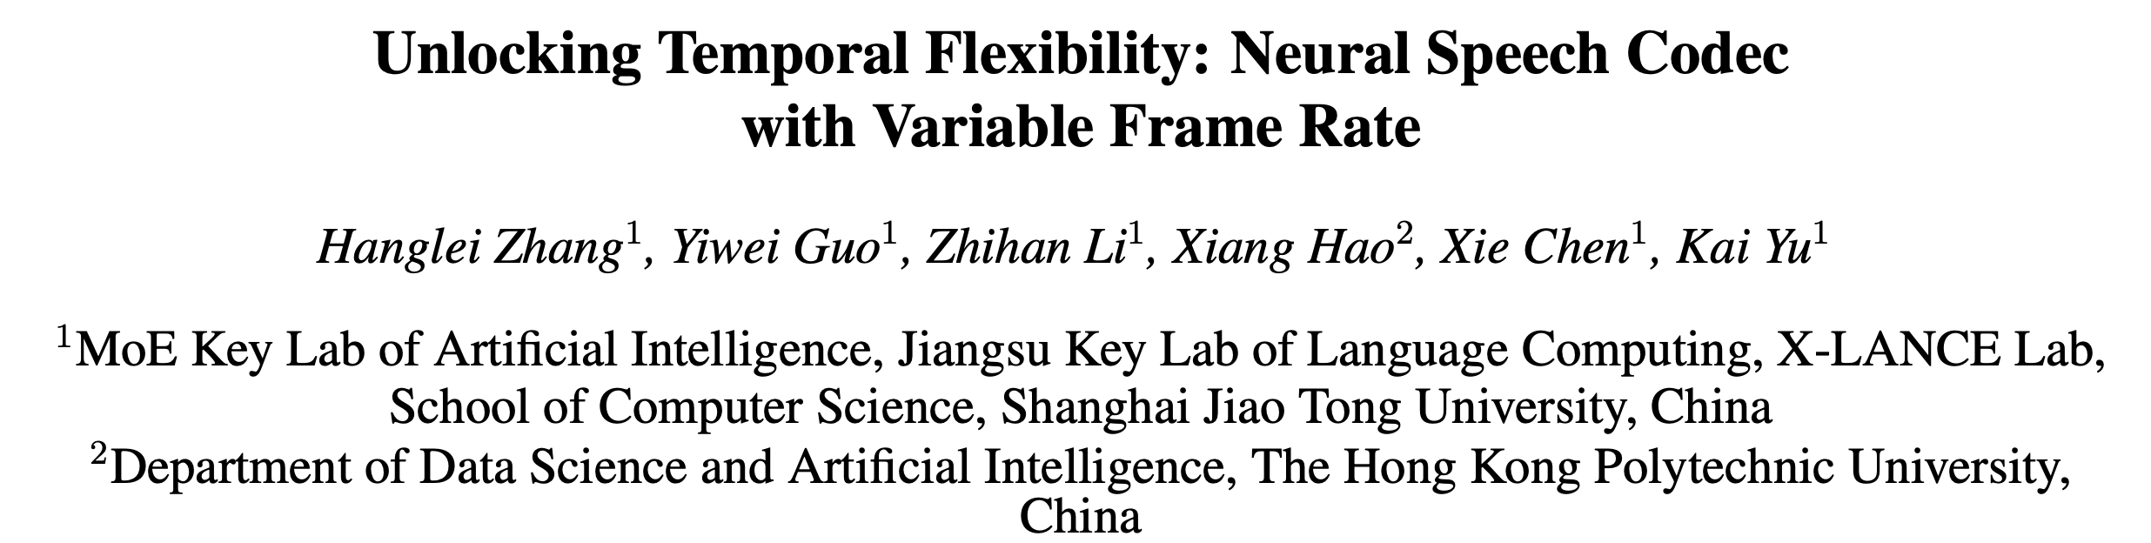
TFC: Entropy-based Dynamic Frame Rate Allocation
BPE is not very effective for single-layer acoustic tokens
Multi-layer tokens: BPE is less reasonable
Almost no VFR in acoustic tokens yet.
Challenges:
Fine-grained information makes explicit boundaries not very effective.
We propose to design heuristic strategy to bring VFR into codecs.
Interspeech 2025

Slide 30
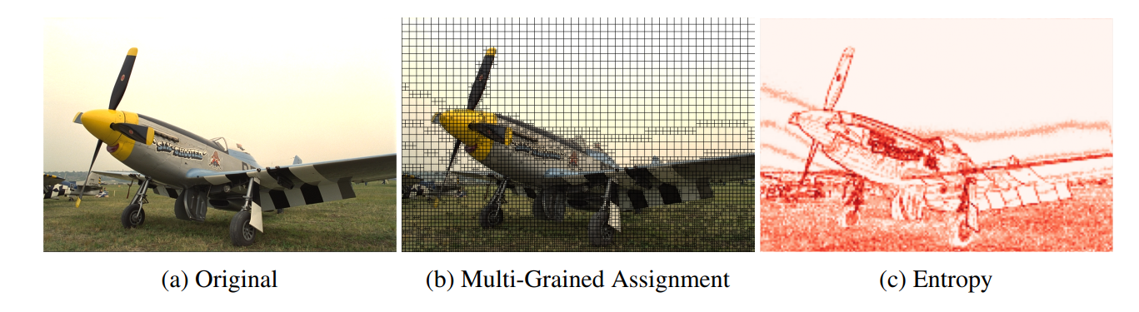
TFC: Entropy-based Dynamic Frame Rate Allocation
Lessons from image compression
Audio signals can be treated like images!
For images:
Patches; Pixels; RGB values.
For audio signals:
Segments; Sampling Points; Quantization Values.
Use Entropy to measure their information density!
Li et al. Once-for-All: Controllable Generative Image Compression with Dynamic Granularity Adaption. In Proc. ICLR 2025.

Slide 31
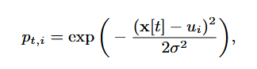
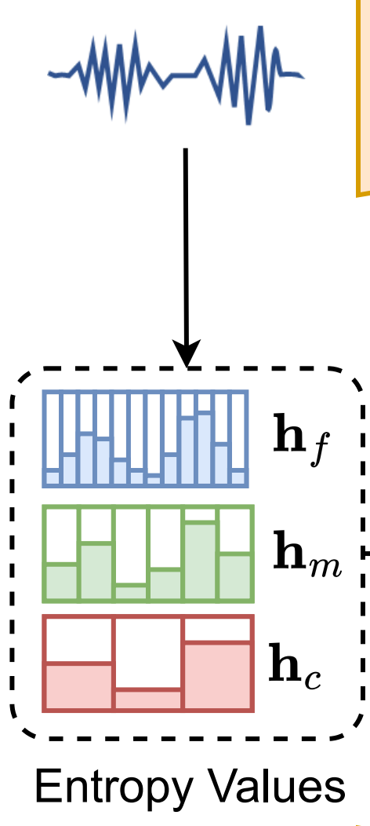
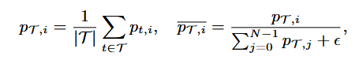
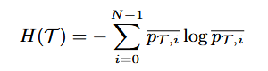
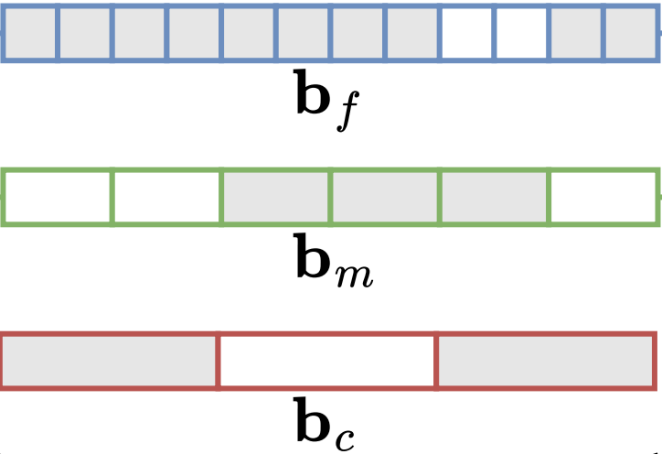
TFC: Entropy-based Dynamic Frame Rate Allocation
Entropy based on Gaussian affinity
Entropy to granularity mask
Different
Granularities
Not use
Use
Not use
By a quantile

Slide 32
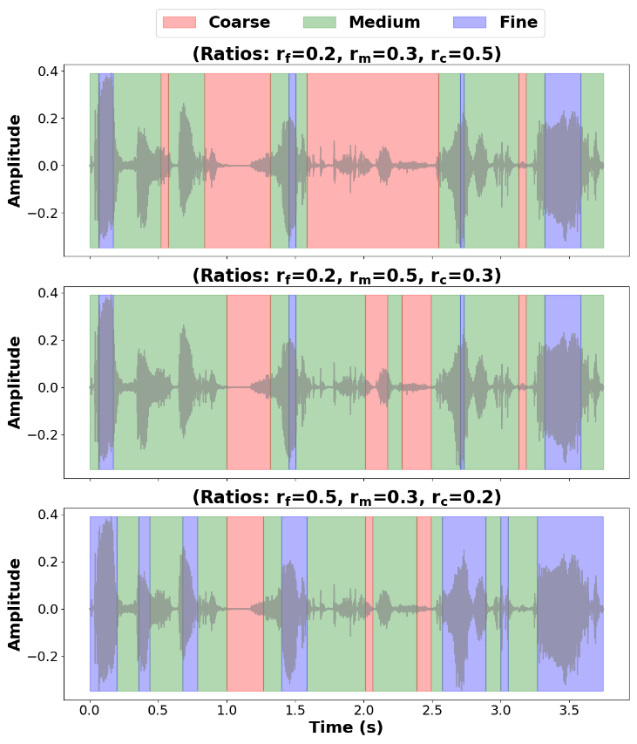
TFC: Entropy-based Dynamic Frame Rate Allocation
Allocation Examples

Slide 33
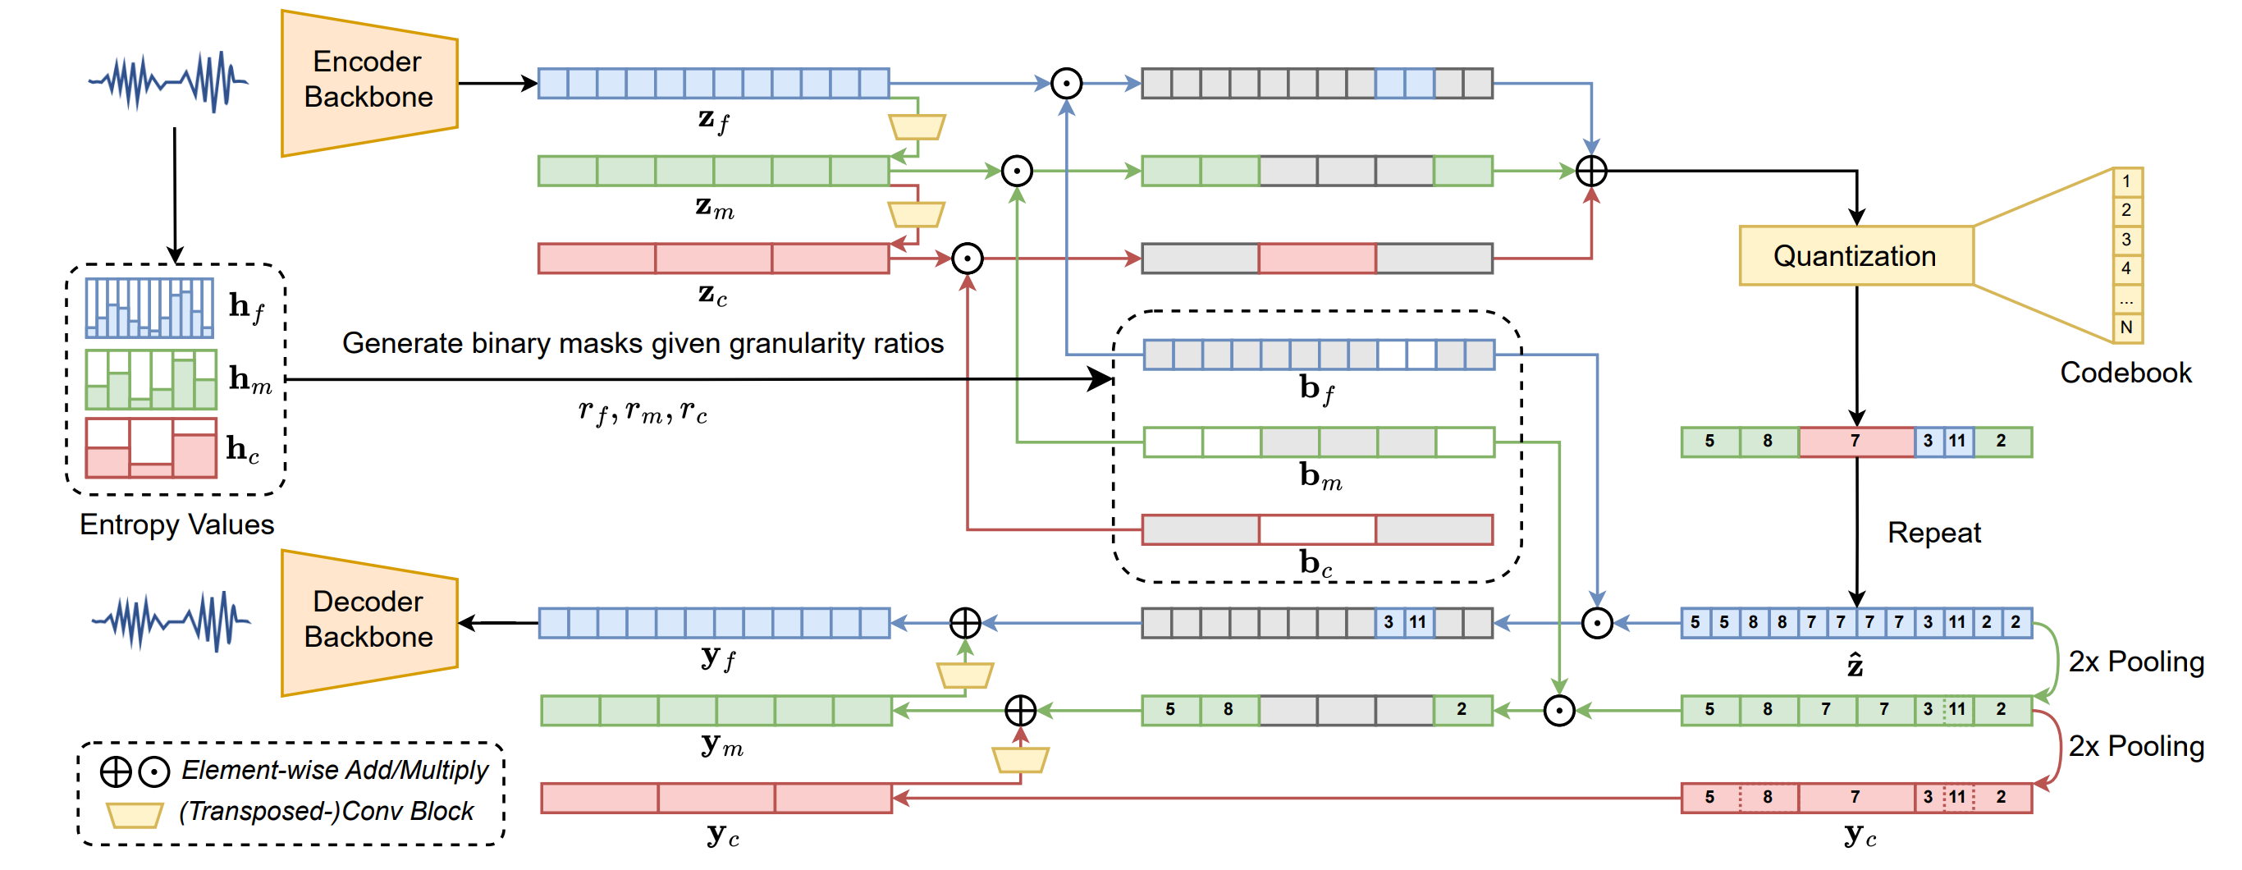
TFC: Entropy-based Dynamic Frame Rate Allocation
With granularity mask, we can select encoded features at different resolutions
Shared quantizer for all resolutions

Slide 34
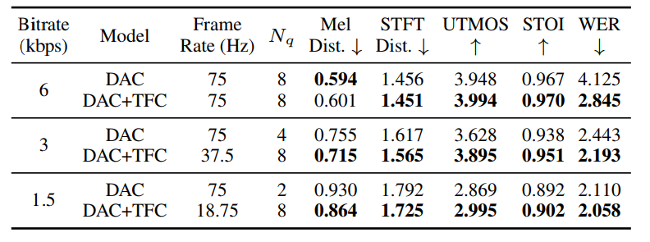
TFC: Entropy-based Dynamic Frame Rate Allocation
Built on DAC backbone
Works within [18.75, 75] Hz with flexible control over frame rate
Even with a constant frame rate, TFC > DAC at the same bitrate.

Slide 35
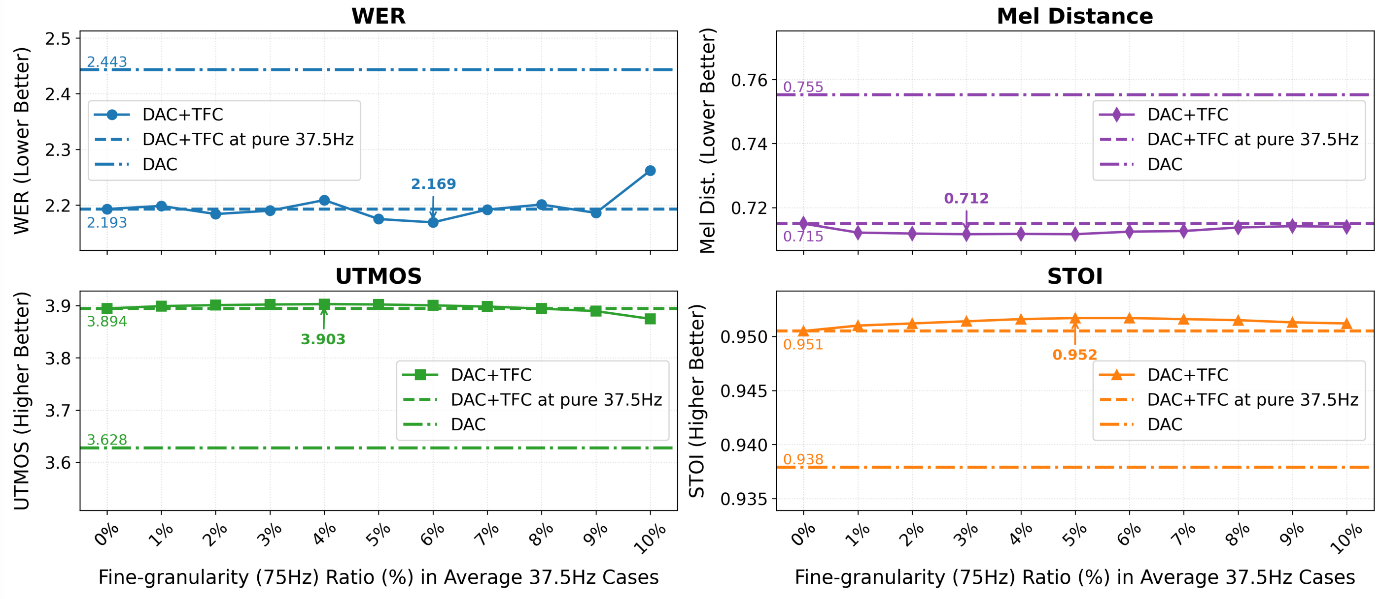
TFC: Entropy-based Dynamic Frame Rate Allocation
True VFR cases: steady performance with different frame rate allocation

Slide 36
TFC: Entropy-based Dynamic Frame Rate Allocation
Conclusion
Generate granularity masks based on entropy values
Select encoded features using granularity masks
Steady improvements both on constant frame rates and VFR cases
First VFR neural acoustic codec (to our knowledge)
Open problems
Entropy might not be a nice metric in noisy environments
Boundaries not strongly related to phonetics

Slide 37
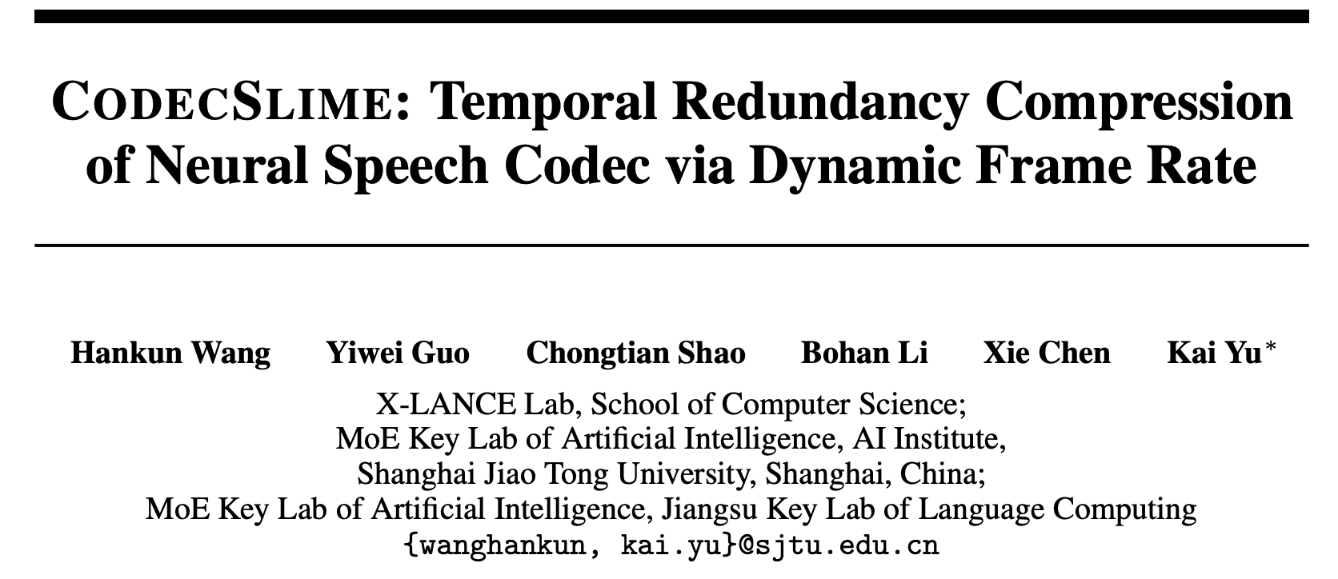
CodecSlime: DP-based Dynamic Downsampling
Instead of entropy, we can let the model decide by it self
By dynamic programming (DP)
Downsampled
Features
Durations
Arxiv:2506.21074
Avg.
3
Codec
Encoder
Avg.
2
1
Avg.
2

Slide 38
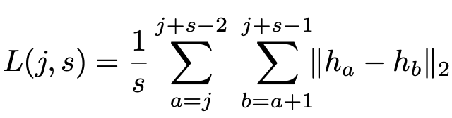
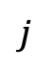
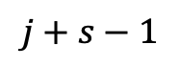
CodecSlime: DP-based Dynamic Downsampling
How to merge frames?
We use pairwise L2 latent distance after preliminary experiments
$$j$$
For segment $[j,j+s)$, segment-level DP cost is from pairwise L2 distances
$$j+s−1$$
This is not a typo 😄
Cost scales linearly with length

Slide 39
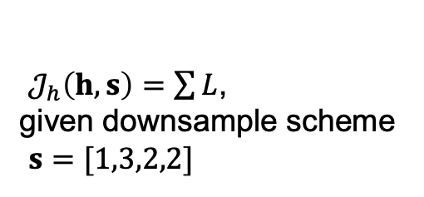
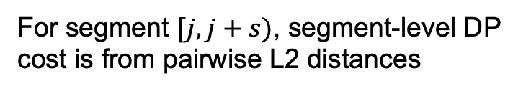
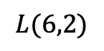
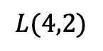
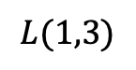
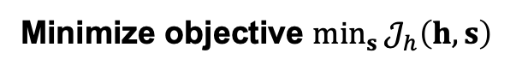
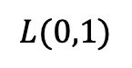
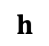
CodecSlime: DP-based Dynamic Downsampling
How to merge frames?
We use pairwise L2 latent distance after preliminary experiments
For segment $[j,j+s)$, segment-level DP cost is from pairwise L2 distances
$$L(0,1)$$
$$L(1,3)$$
$𝒥_{h}\left(h,s\right)=\sum{L}$,
given downsample scheme
$s=[1,3,2,2]$
$$h$$
$$L(4,2)$$
$$L(6,2)$$
Minimize objective $\min_{s}{𝒥_{h}\left(h,s\right)}$

Slide 40
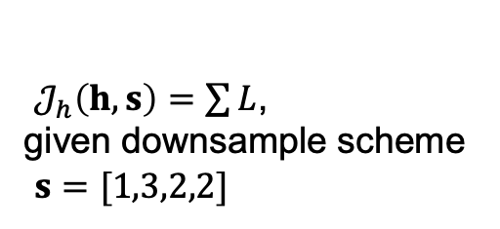
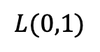
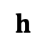
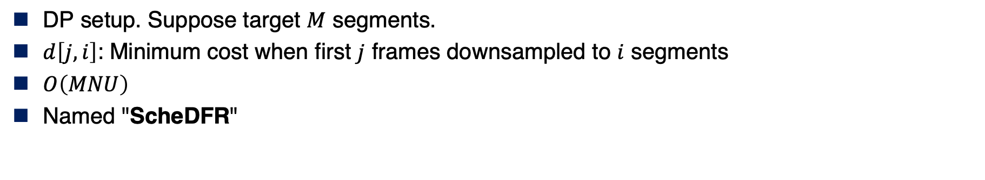
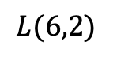
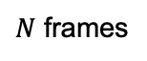
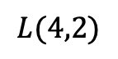
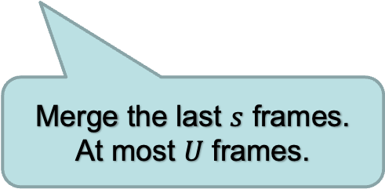
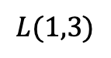

CodecSlime: DP-based Dynamic Downsampling
DP setup. Suppose target $M$ segments.
$d\left[j,i\right]$: Minimum cost when first $j$ frames downsampled to $i$ segments
$O\left(MNU\right)$
Named "ScheDFR"
$$d\left[j,i\right]=\min_{1≤s≤U}\left\{d\left[j−s,i−1\right]+L\left(j,s\right)\right\}$$
$$L(0,1)$$
Merge the last $s$ frames. At most $U$ frames.
$$L(1,3)$$
$𝒥_{h}\left(h,s\right)=\sum{L}$,
given downsample scheme
$s=[1,3,2,2]$
$$h$$
$$L(4,2)$$
$$L(6,2)$$
$N$ frames

Slide 41



CodecSlime: DP-based Dynamic Downsampling
Staged training process: Melt-and-Cool
Single-layer quantizer design
VFR model for various downsampling schemes
VFR model finetuned for a target frame rate
Fixed frame rate model
"Melt"
"Cool"
w/ ScheDFR
To adapt the model to VFR scenarios
To adapt quantizer & decoder to specific target rates

Slide 42
CodecSlime: DP-based Dynamic Downsampling
The Melt stage randomly samples different downsampling schemes $s$ for each utt.
Easy to hard: no downsampling at first, gradually to a preset distribution of $s$
VFR model for various downsampling schemes
Fixed frame rate model
Necessity
The pairwise distance from a fixed-frame-rate model may not be sufficient for ScheDFR.
Explorations into VFR cases may inspire model to have this property.
"Melt"

Slide 43
CodecSlime: DP-based Dynamic Downsampling
The Cool stage finetunes the model to focus on a target average frame rate (e.g. 40Hz)
Encoder is frozen
ScheDFR is introduced in this stage
The finetuned model still has generalizability to other target frame rates
VFR model for various downsampling schemes
VFR model finetuned for a target frame rate
Necessity
The Melted model has seen various downsampling schemes.
But they are random and not informative.
"Cool"
w/ ScheDFR

Slide 44

CodecSlime: DP-based Dynamic Downsampling
With VFR, avg. 40Hz codec outperforms fixed 40Hz codec.

Slide 45

CodecSlime: DP-based Dynamic Downsampling
Built upon BigCodec backbone.
Outperforms various low-bitrate codecs, especially in speech intelligibility
Better result with the same avg. frame rate

Slide 46


CodecSlime: DP-based Dynamic Downsampling
Backbone + Melt
Avg. pooling 80->40Hz
Backbone + Melt-and-Cool
Avg. pooling 80->40Hz
Melt is necessary before ScheDFR finetuning

Slide 47
Contents
1
Discrete Speech Tokens: Taxonomy
2
Reducing Speaker Redundancy: Disentanglement
3
Reducing Temporal Redundancy: Variable Frame Rate
4
Conclusion

Slide 48
Conclusion
Speaker timbre disentanglement
Helps achieving lower bitrates
Capable of voice conversion
LSCodec (single-codebook, 0.45kbps / 0.25kbps)
Temporal redundancy reduction, variable frame rate tokenization
Entropy-based frame rate selection (TFC)
DP-based dynamic downsampling (CodecSlime)
Staged training is usually adopted
Open problems:
Advantage of those tokens in TTS and SLM
Semantic abilities?
Unsupervised or text supervision?

Slide 49
Related Work
Guo, Y., Li, Z., Wang, H., Li, B., Shao, C., Zhang, H., ... & Yu, K. (2025). Recent advances in discrete speech tokens: A review. arXiv preprint arXiv:2502.06490.
Guo, Y., Li, Z., Du, C., Wang, H., Chen, X., & Yu, K. (2024). LSCodec: Low-bitrate and speaker-decoupled discrete speech codec. arXiv preprint arXiv:2410.15764.
Shen, F., Guo, Y., Du, C., Chen, X., & Yu, K. (2024, April). Acoustic bpe for speech generation with discrete tokens. In ICASSP 2024-2024 IEEE International Conference on Acoustics, Speech and Signal Processing (ICASSP) (pp. 11746-11750). IEEE.
Li, B., Shen, F., Guo, Y., Wang, S., Chen, X., & Yu, K. (2024). On the effectiveness of acoustic bpe in decoder-only tts. arXiv preprint arXiv:2407.03892.
Zhang, H., Guo, Y., Li, Z., Hao, X., Chen, X., & Yu, K. (2025). Unlocking Temporal Flexibility: Neural Speech Codec with Variable Frame Rate. arXiv preprint arXiv:2505.16845.
Wang, H., Guo, Y., Shao, C., Li, B., Chen, X., & Yu, K. (2025). CodecSlime: Temporal Redundancy Compression of Neural Speech Codec via Dynamic Frame Rate. arXiv preprint arXiv:2506.21074.

Slide 50
Thank you!

